Slide 1

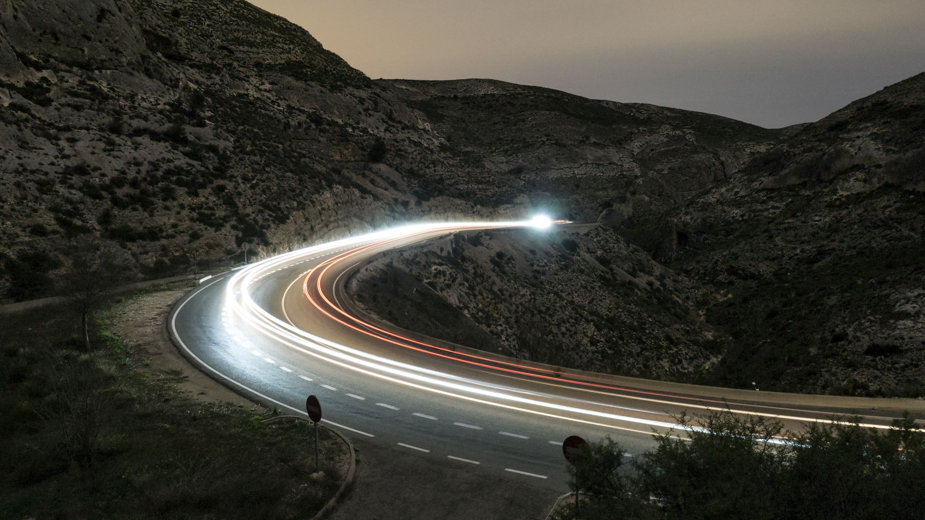
Objectively quantifying car performance on track

Slide 2
Motivation behind project
My friends and I have a passion for cars that extends beyond racing games.
Racing drivers will feel more comfortable with different cars based on their driving characteristics – we wanted a method of measuring potential track performance while eliminating the driver from the equation.
Creating a more objective way of comparing performance between cars.
A fun way of applying mathematics to real world situations.

Slide 3
Gathering Racetrack data
As a group we collectively decided to focus on the racetrack Laguna Seca at first.
We scoured the internet for data to map out all of the tracks corners and straights however no such data could be found.
I came up with the idea of using Google Earth due to the measuring tools available.
Before measuring specific parts of the track we measured the entire track and compared our measured length to the distance stated online and on the track’s website if there is one.
After validating our initial measurement we then separated the track into a collection of corners and straights and measured them separately.

Slide 4
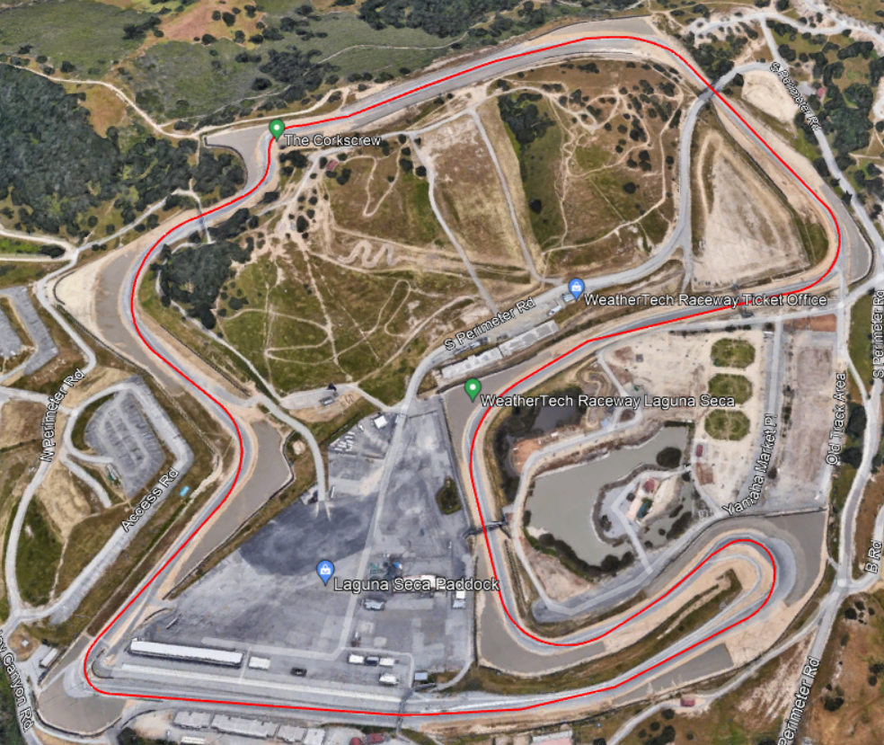
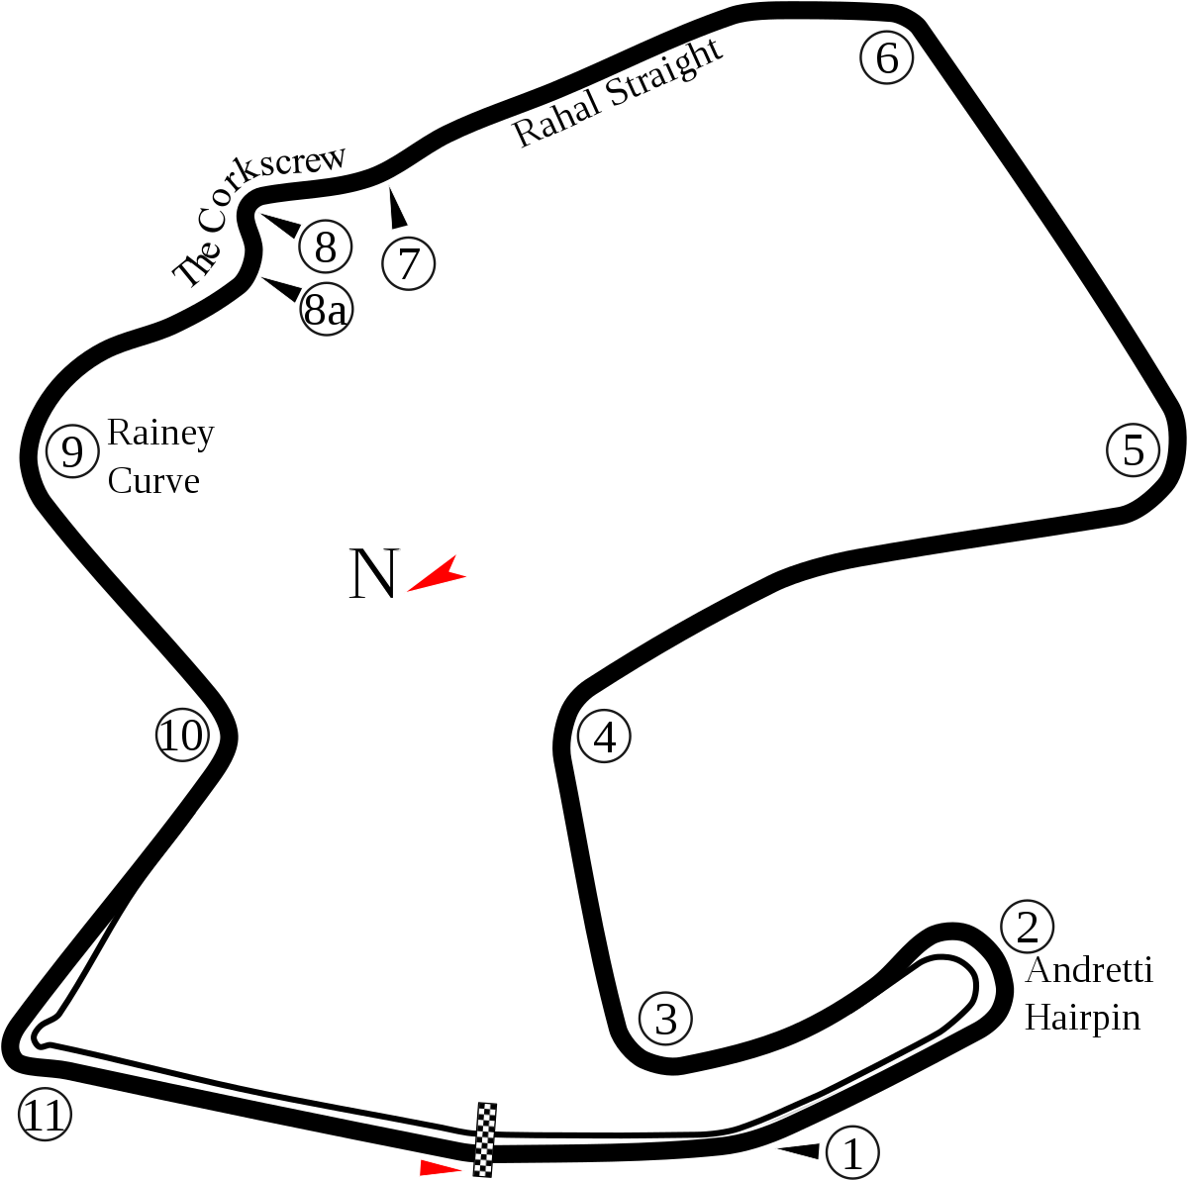
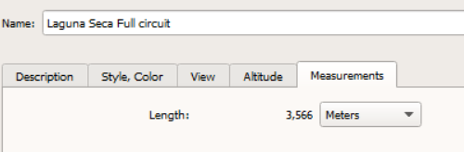
Example: Laguna seca
An online image of the track compared to a Google Earth Image with our measurements.
The track length we measured was 3566 metres which is approximately 2.22 miles which is only a 0.8% difference from the actual 2.236 which could be due to the fact we measured along the ‘racing lines’ however we do not know the original track measuring methods.

Slide 5
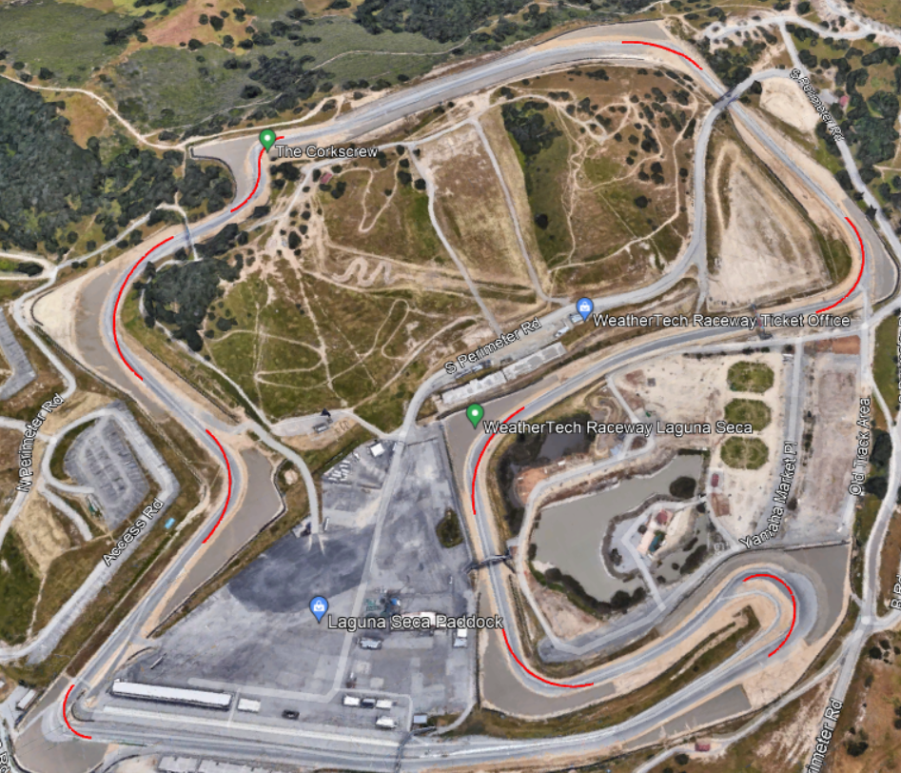
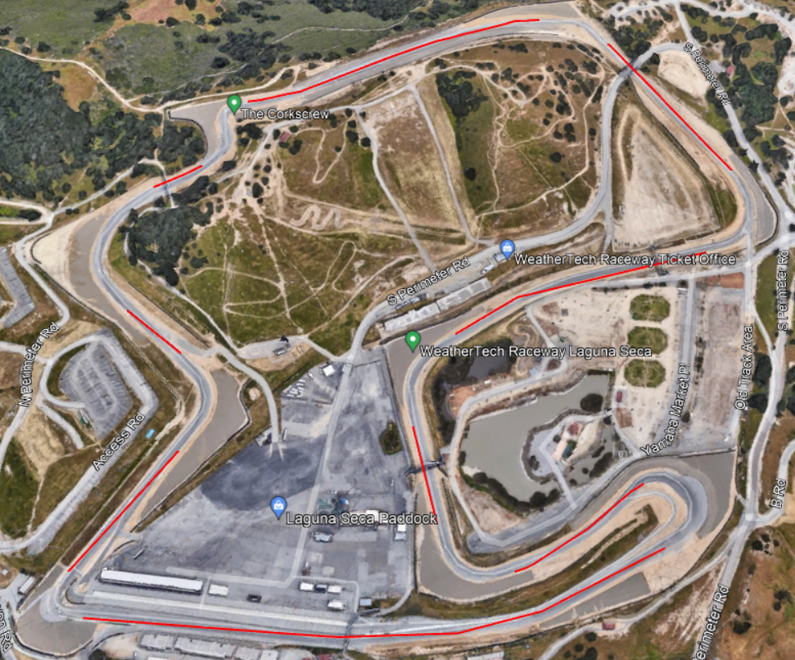
Measuring corners and straights
Mapped corners as a circular path; the easiest and best method of measuring cornering speed is using circular motion rules.
Sections between corners are assumed to be ‘straight’ as they wont require cars to slow down even though the path isn’t always completely straight.

Slide 6
Gathering Car data
For this presentation I will be using the 2016 Dodge Viper ACR-E and the 2010 Bugatti Veyron Supersport.
Despite already knowing many of the specs including necessary data we still visited multiple websites such as the original manufacturer sites, fastestlaps, evo and motortrend to verify our numbers.
 | Bugatti Veyron Supersport | Dodge Viper ACR-E
0-60mph (26.8224m/s) | 2.4 secs | 3.3 secs
Standing quarter mile | 9.9secs@146mph (65.268m/s) | 11.5secs@127.3mph(56.908m/s)
0-186mph(83.149m/s) | 14.6secs | N/A (top speed 177mph)
Mass | 1990kg | 1538kg
Downforce | 400kg@250mph (3924N@114.442m/s) | 544.3kg@150mph 771kg@177mph (5339.583N@67.056m/s 7563.51N@79.126m/s)
Power Torque | 1183bhp 1106lb-ft | 645bhp 600lb-ft

Slide 7
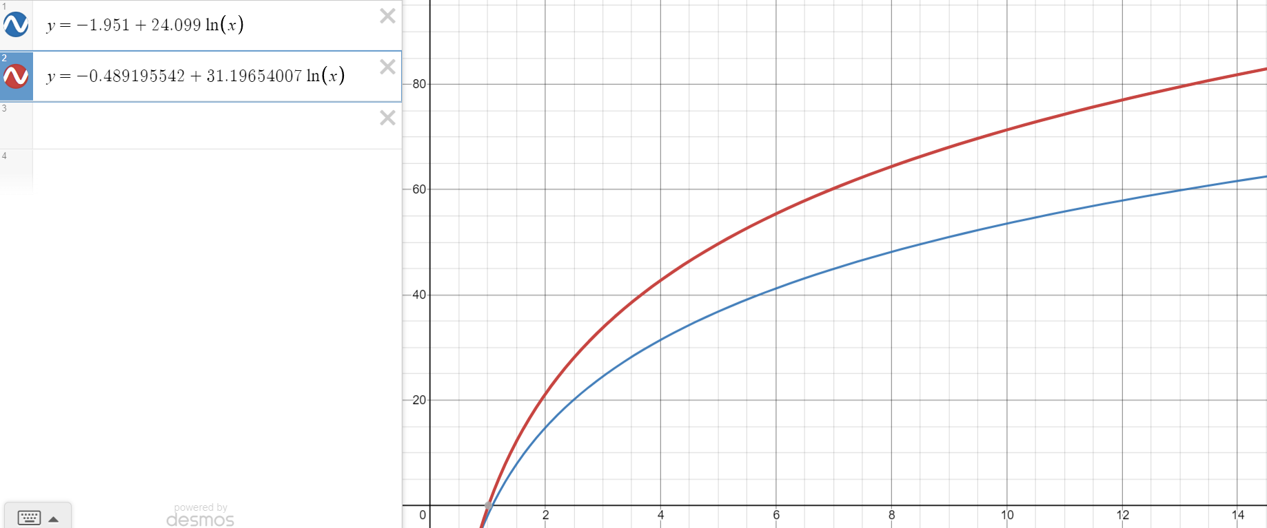
Interpolating data
Assume downforce is constant, using figure at 150mph for both cars(this figure is quoted by many manufacturers although not all); as downforce increases with the square of velocty we calculated the approximate downforce of the Bugatti to be (150² / 250²)x(3924)=1412.64N
To create a velocity time graph for each car we used the given data points relating speed and time and used a calculator to create a logarithmic regression equation for each car as the velocity time graph of a car typically follows a path similar to a logarithmic curve. Although a limitation for this method is neither of the graphs pass through the origin meaning the data is most likely getting increasingly inaccurate at slower speeds.
The blue line represents the Dodge Viper and the red represents the Bugatti showing a sizeable difference in acceleration.
V(m/s)
t(seconds)

Slide 8
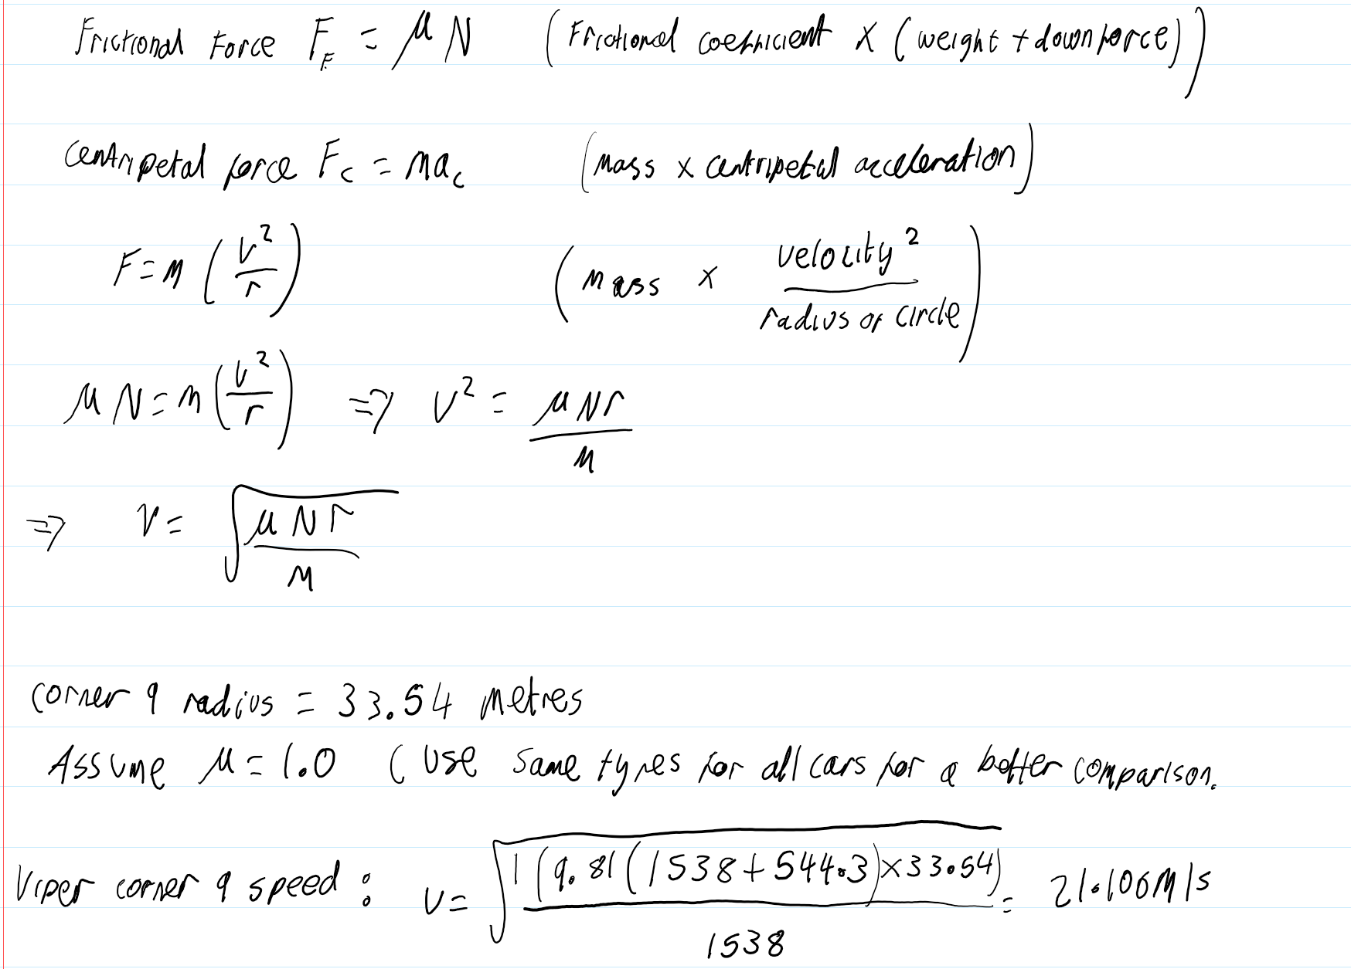
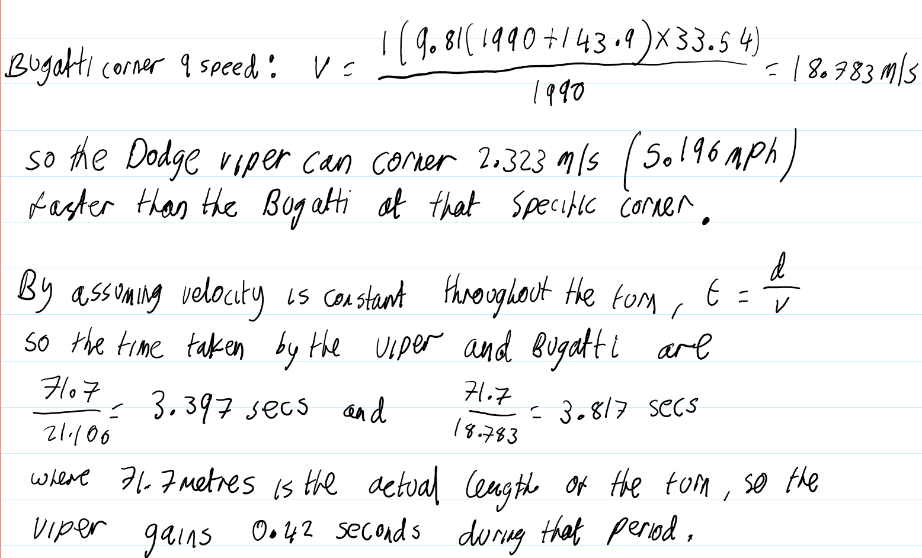

Calculating cornering speed
Assume tyres used are the same across all cars (coefficient of friction=1)
Assume braking is instant and speed is constant throughout a corner.
Assume all corners are flat (no banking and no elevation changes).

Slide 9
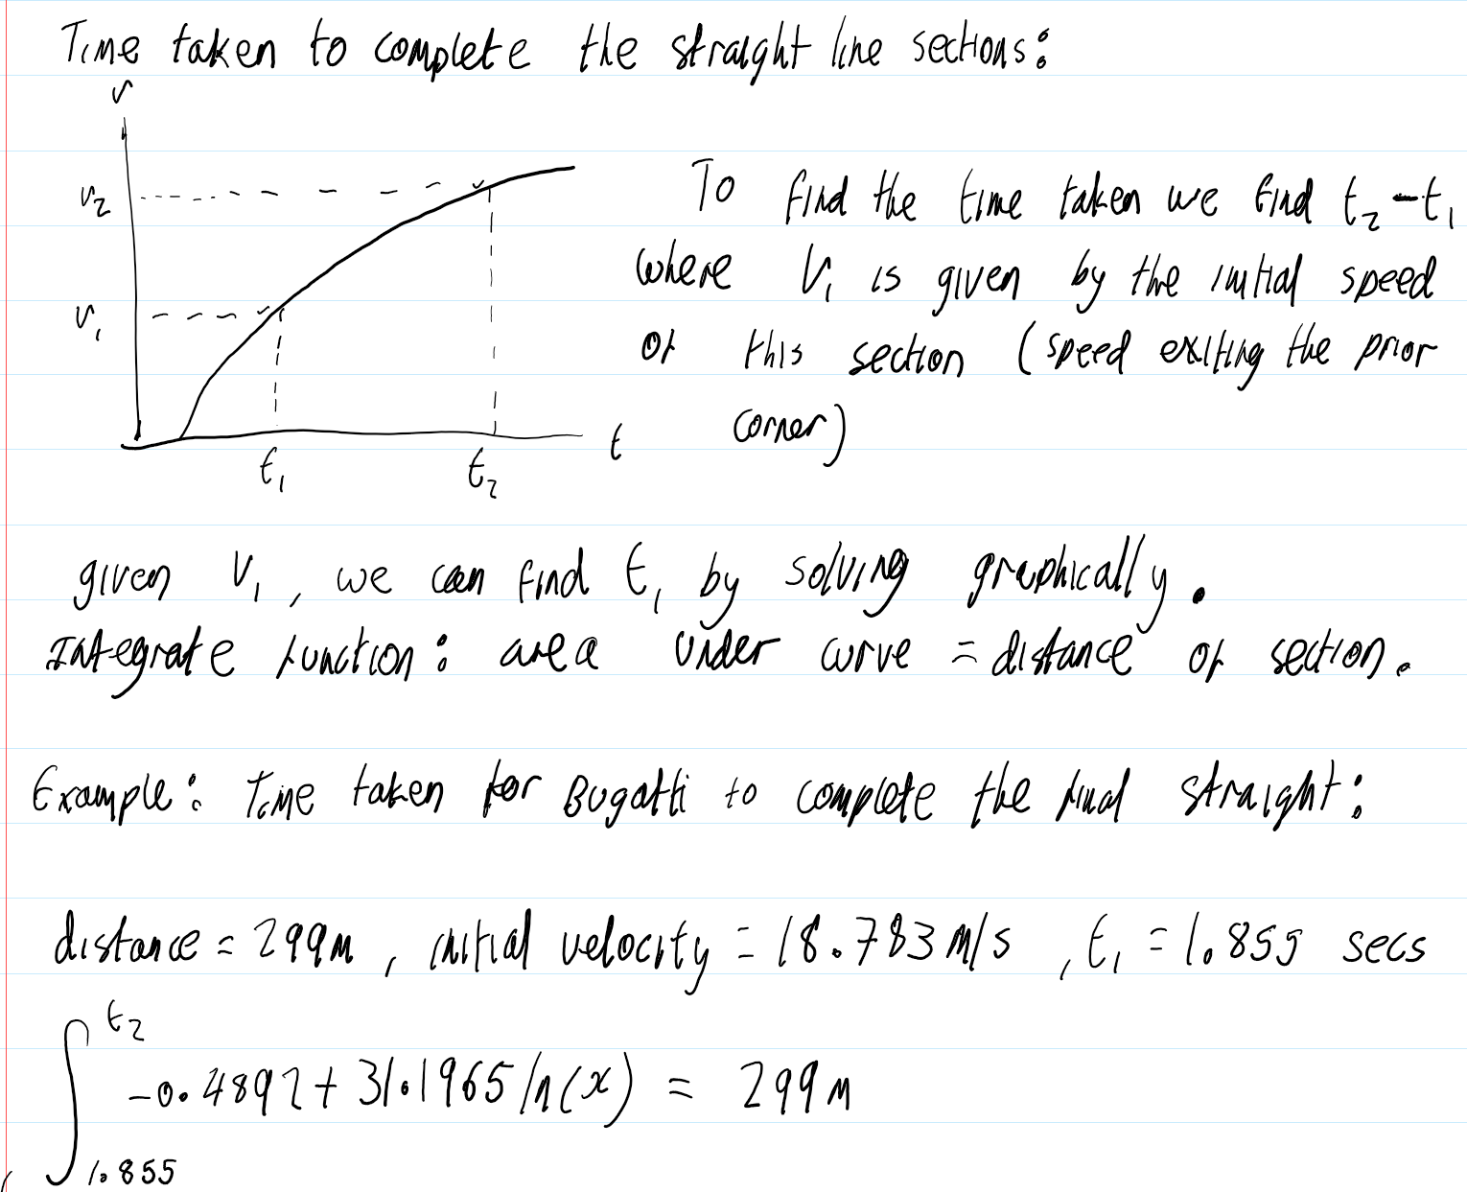
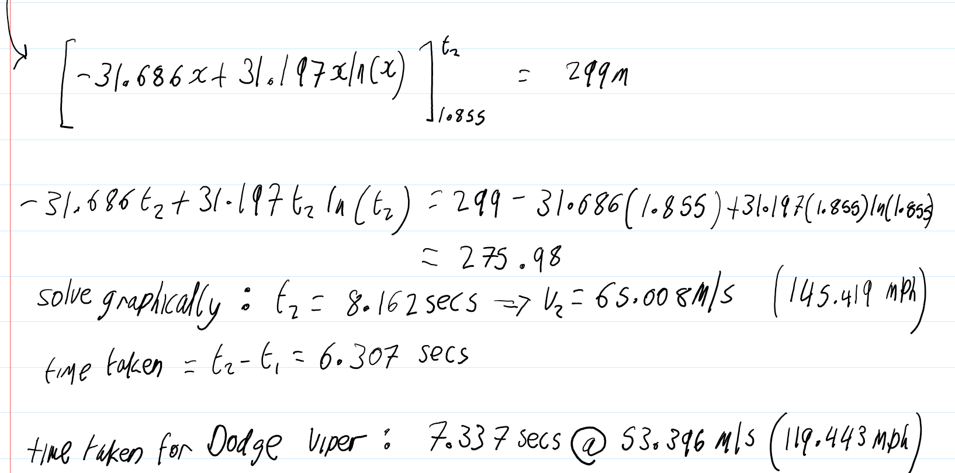
Calculating straight line speed
By assuming braking is instant, as a result the straight line acceleration sections are longer than they would be in the real world.
Also assumed no elevation changes for straight sections.

Slide 10
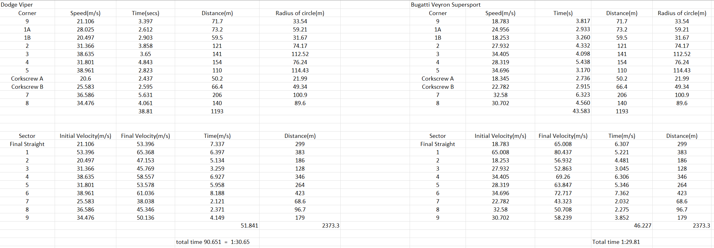
Keeping track of data
Used spreadsheets to keep track of the data for straight line and cornering performance for each car separately before combining everything together
According to this model the Dodge Viper is 4.77 seconds quicker around the corners overall while the Bugatti shines on the straight lines, outperforming the Viper by 5.61 seconds on the straight line sections

Slide 11
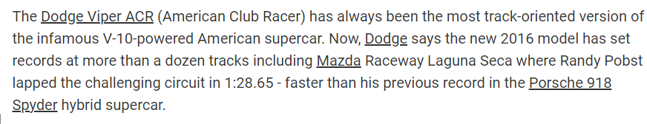
Comparison to real life
According to my model, as seen on the excel spreadsheet, the Dodge Viper managed a simulated lap time of 1:30.65 which is only 2 seconds off or a 2.26% difference from the 1:28.65 time achieved in the real world.
A reason for this could be I make the assumption all cars use the same tyres and have a frictional coefficient of 1 (in order to have a much more even comparison) whereas the Viper’s original tyres are much stickier and manage a coefficient of 1.15. In addition to this is the fact that this model assumes cornering speed is constant throughout.

Slide 12
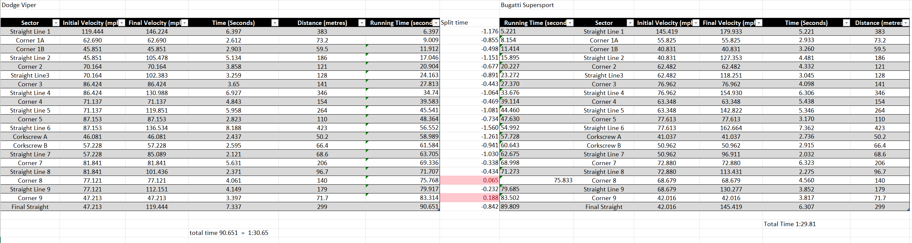
Overall comparison of the 2 cars
Laps are simulated as rolling start hot laps; can simulate a head to head race by either setting the initial velocity of straight line equal for both cars or by setting both to 0 to simulate a standing start, where, in this case the times would be much closer.
This is how we compare different cars at different tracks where we can review performance at specific sectors of the track

Slide 13
Conclusion
I believe this project to be a success; although the times I estimate are slightly different from what has been achieved in real life which affects my predictions of unrecorded times, the variation is only a few percentage points (under 5%) off.
This has enabled me to compare the performance of different cars at different tracks under the same circumstances (eg same tyres), given just a few different specs, most of which are easy to find.

